Slide 1
Traffic Flow Forcasting and Visualization Group 5 Weilin Ruan, Qiongyan Wang, and Rui Zhang

Slide 2


Table of Content
01 What
- What’s the data?
02 Why
- Why these data matters?
03 How
- How we visualize these data?

Slide 3
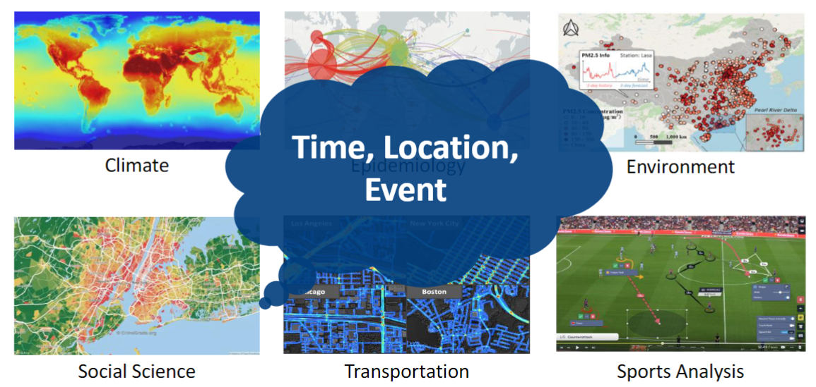
What’s the spatio-temporal data?
Data like climate / traffic / urban mobility that have both spatial distribution characteristics and temporal variation characteristics, so they are called spatio-temporal data.

Slide 4
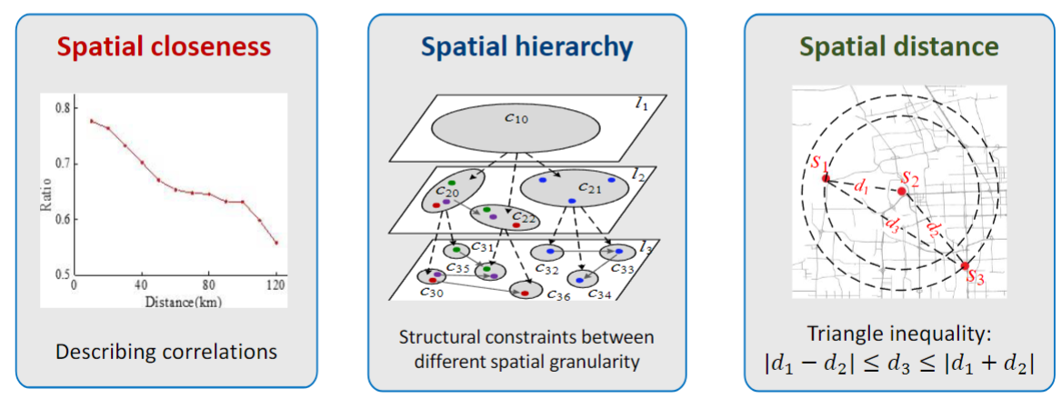
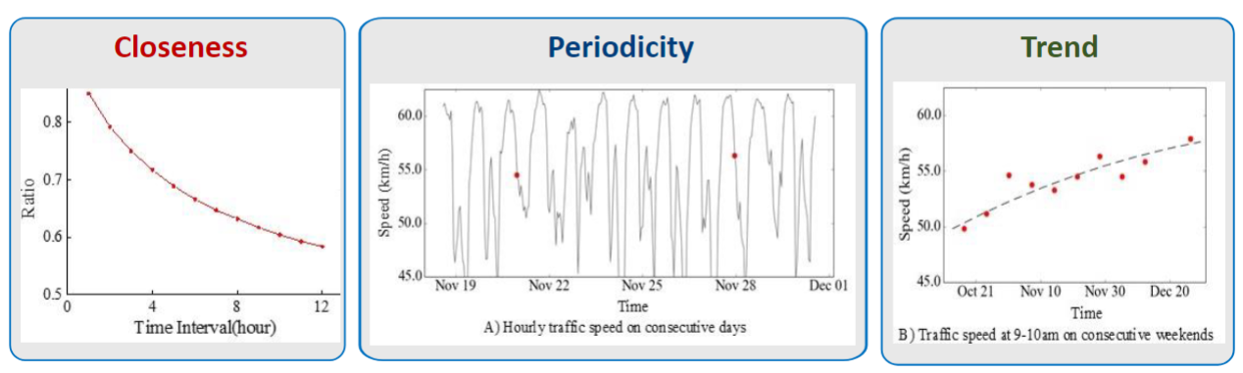
Data Attributes of ST Data - An overview
Spatial property
Temporal property

Slide 5
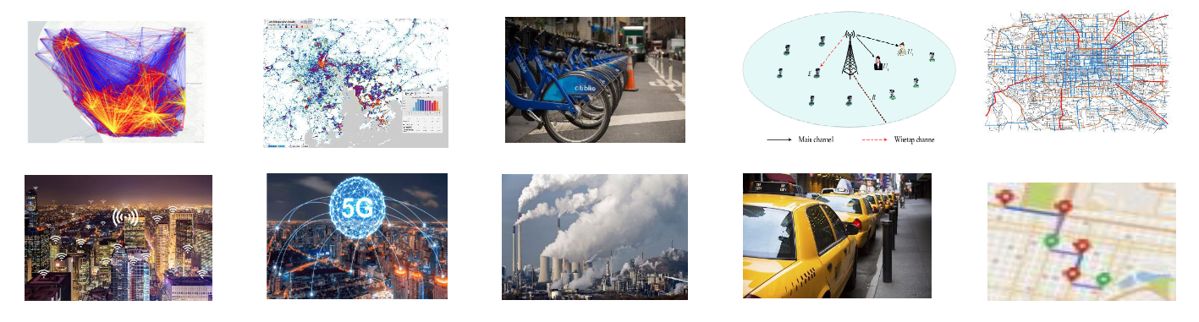
Why Spatio-temporal Data Matters?
1. Diverse Spatio-Temporal Scenarios
From traffic flow to energy management to economic forecasting, multivariate time series forecasting plays a central role in a wide range of fields, helping decision makers make more accurate judgments.
2. Complexity of the Data
Multivariate time series data contain multiple interrelated variables, and their complex spatio-temporal patterns and intrinsic dependencies pose a serious challenge to forecasting models.
3. Estimated value
Accurate forecasting of future trends relies not only on the analysis of a single time series, but also on the consideration of the interactions between series, which is crucial for optimizing resource allocation and improving efficiency.

Slide 6
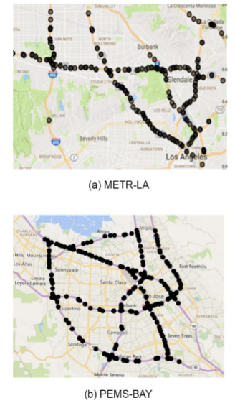
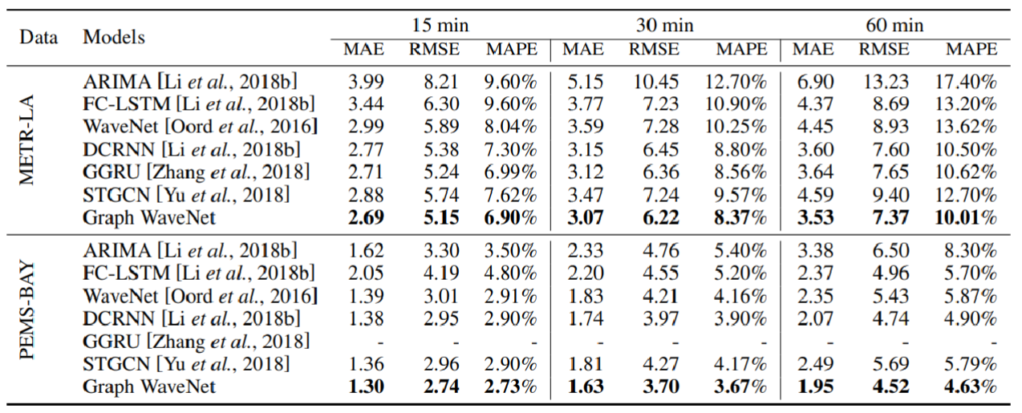
What’s the traffic flow forecasting?

Slide 7
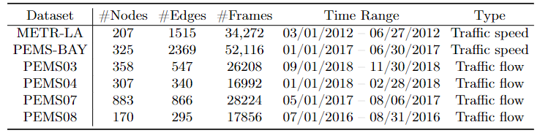
Attributes of traffic dataset
The datasets are derived from real-world traffic flow data, such as the PEMS04 dataset, which contains multiple time steps and hundreds of sensors capturing actual traffic flow information.
The dataset contains attributes such as traffic flow, speed, etc., which reflect the number of vehicles passing through each roadway and are key information for making traffic flow predictions.
Effective data visualization can help managers and planners understand changes in traffic flow more intuitively, which is critical for developing traffic management strategies and optimizing traffic routes.

Slide 8
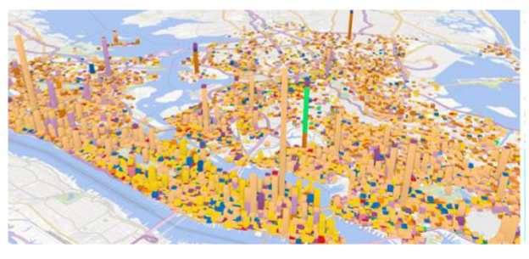
More Details of traffic features
1. Traffic Flow: The count of vehicles passing a sensor within each five-minute interval. For instance, if flow is 50, it means 50 vehicles passed the sensor during that interval.
2. Average Speed: The mean speed of vehicles at each sensor for the same five-minute interval, measured in miles or kilometers per hour. An entry might show speed as 65, indicating an average speed of 65 mph during that period.
3. Occupancy: This is the percentage of time a given road segment was occupied by vehicles, which indirectly indicates congestion. For instance, occupancy at 30% means that for 30% of the interval, the road was occupied by vehicles.
4. Timestamp: Each entry is time-stamped, enabling temporal analysis. A sample timestamp might be "2018-01-01 08:00:00", referring to data collected at 8:00 AM on January 1, 2018.
5. Distance Matrix: Contains precomputed distances between sensor
pairs in meters, which allows for spatial analysis of traffic patterns. For
example, if the distance between Sensor 1 and Sensor 2 is recorded as
500 meters, it enables network connectivity modeling.

Slide 9
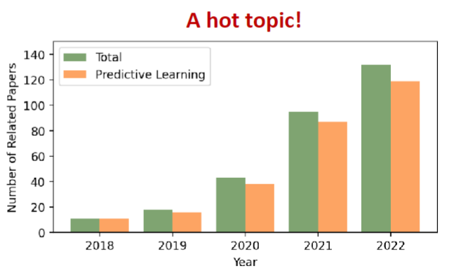
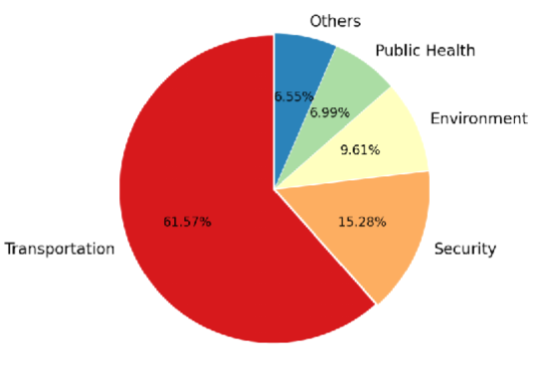
Why Traffic Flow Forecasting Matters?
Traffic flow forecasting is a critical tool that supports efficient and sustainable urban transportation systems. By providing accurate predictions, it enables better traffic management, infrastructure planning, and public transportation optimization, ultimately leading to improved economic, environmental, and social outcomes.

Slide 10
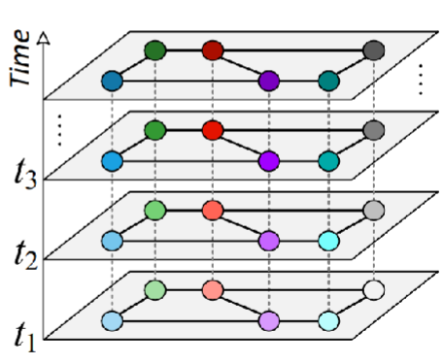
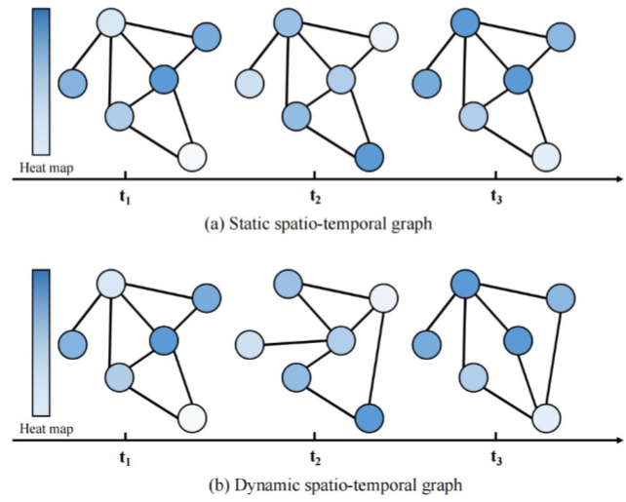
Modeling of Spatio-temporal Graph
Spatio-temporal graphs are commonly used in various fields, including transportation, urban planning, environmental monitoring, social media analysis, and more.

Slide 11
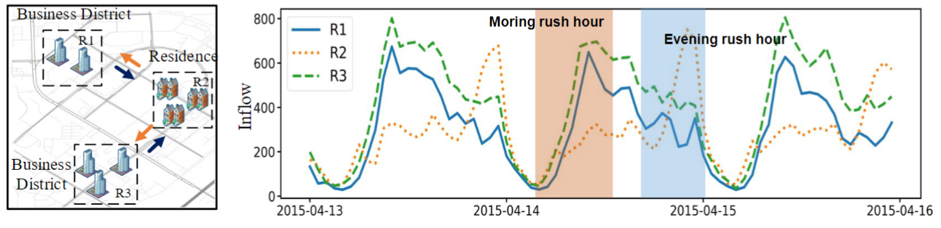
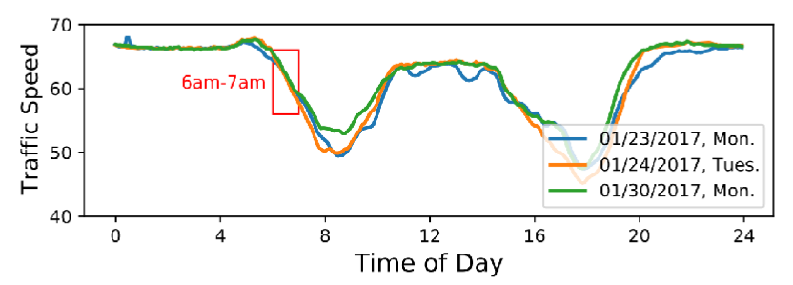
Motivation – Map and Waveform
Using maps and waveforms together provides a powerful and comprehensive way to visualize and understand traffic flow. Maps offer spatial context and visual clarity, while waveforms provide detailed temporal insights.

Slide 12
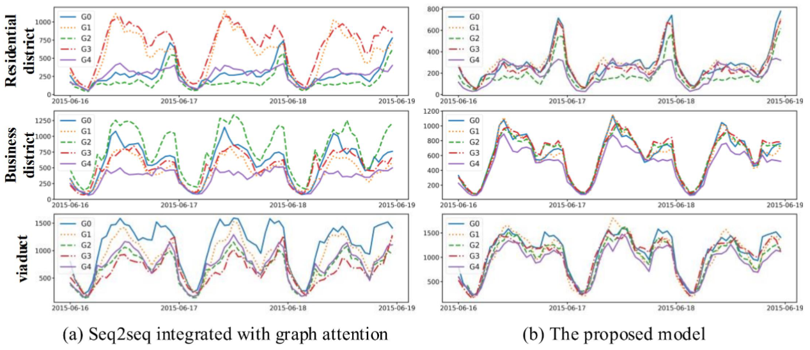
Line Chart - Learned Location Embedding

Slide 13
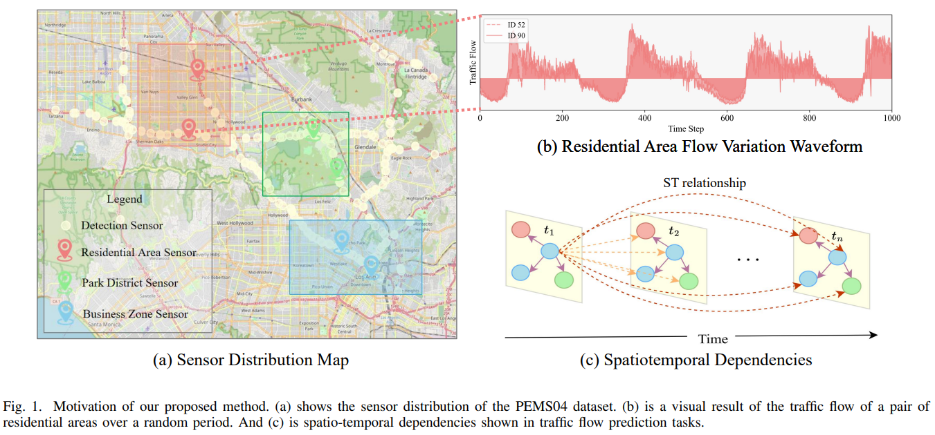
Our Visualization

Slide 14
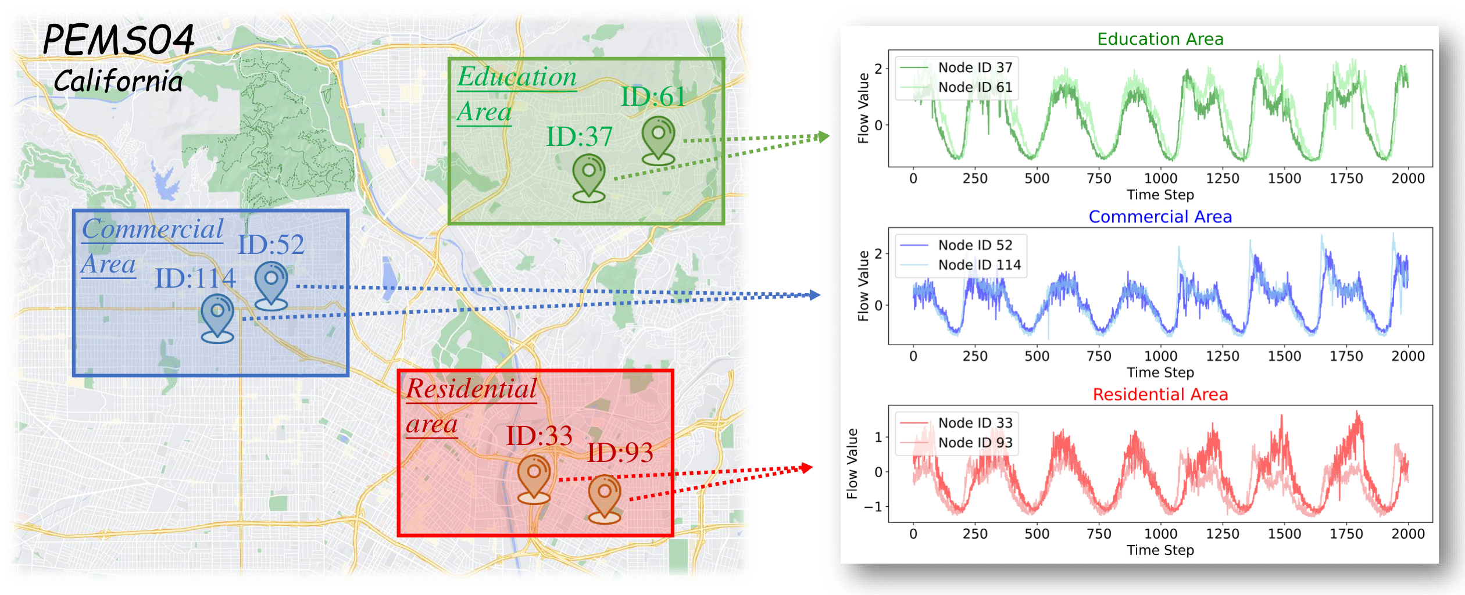
Other style of Motivation
Notes:
So the representation of the spatio-temporal graph is equivalent to the illustration on the right figure,
where we can see that the nodes and the relationships between them change over time.
Some of the symbols we usually use are explained below: G=(V,E) denotes a graph G with nodes set V and edge set E.
And N is the number of nodes, A is the N by N adjacency matrix. And since each node is characterized in dimension D at some point in time,
We use the N × T matrix X. For the simplest spatio-temporal graph prediction task

Slide 15
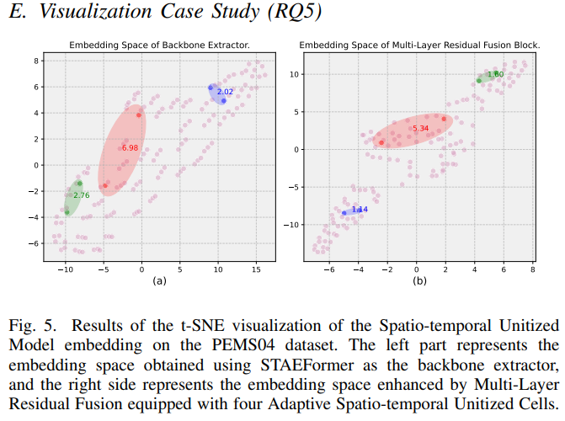
t-SNE Visualization
t-SNE (t-distributed Stochastic Neighbor Embedding) is a powerful technique for dimensionality reduction and visualization, particularly useful for visualizing high-dimensional datasets in two or three dimensions. It has become a popular method in machine learning and data science for exploring complex data structures.
Applications
Data Exploration: t-SNE is widely used for visualizing high-dimensional data to gain insights into the underlying structure.
Clustering: While t-SNE itself does not perform clustering, the resulting 2D or 3D plots can help identify natural groupings in the data.
Feature Engineering: t-SNE can be used to visualize the effectiveness of different feature sets or transformations.

Slide 16
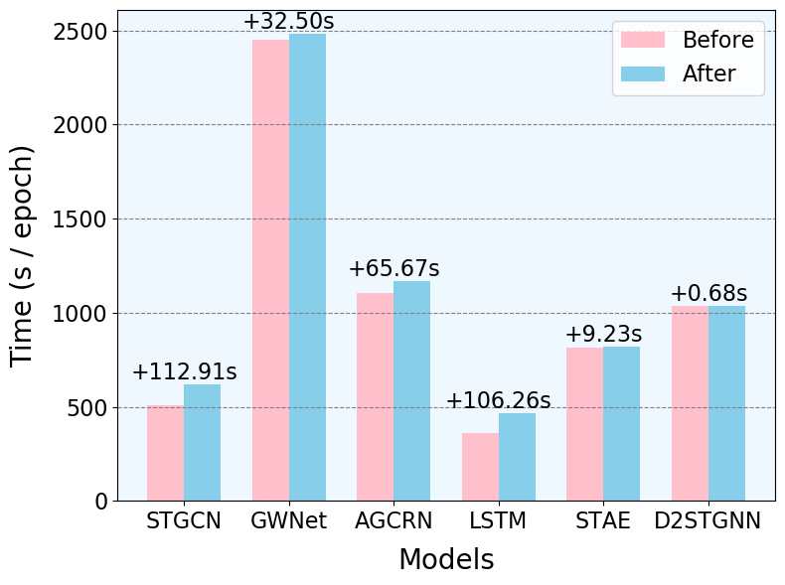
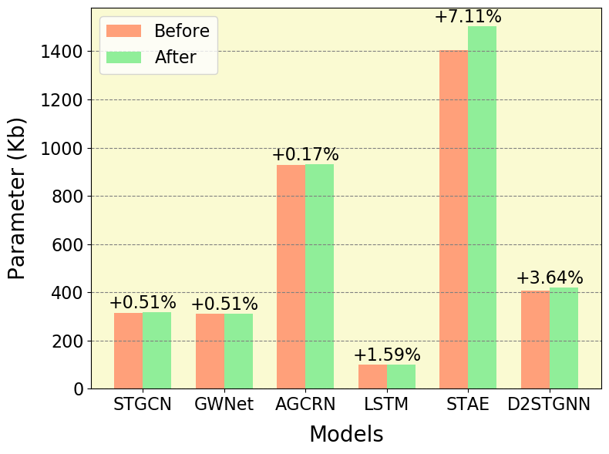
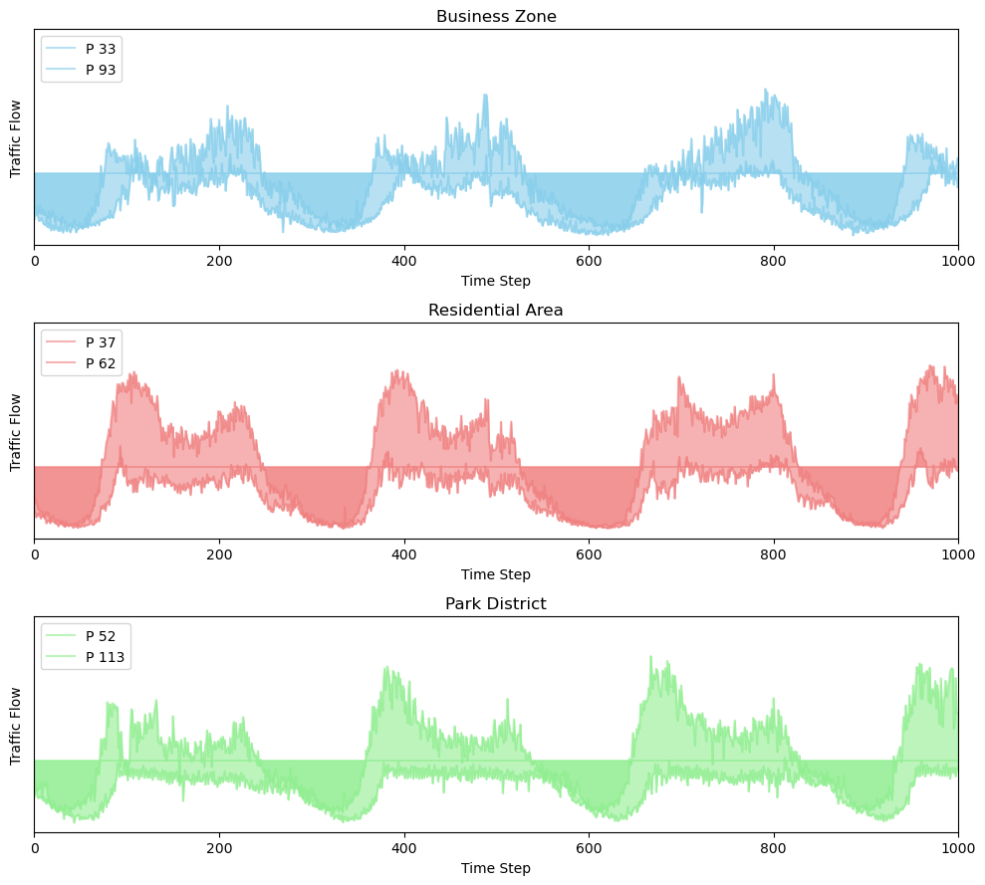
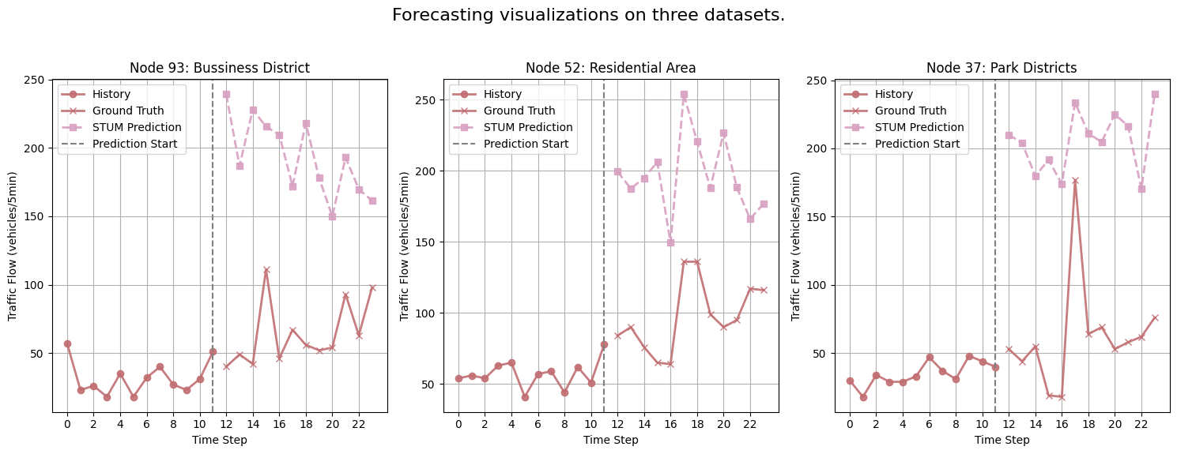
Forecasting and Case Study

Slide 17
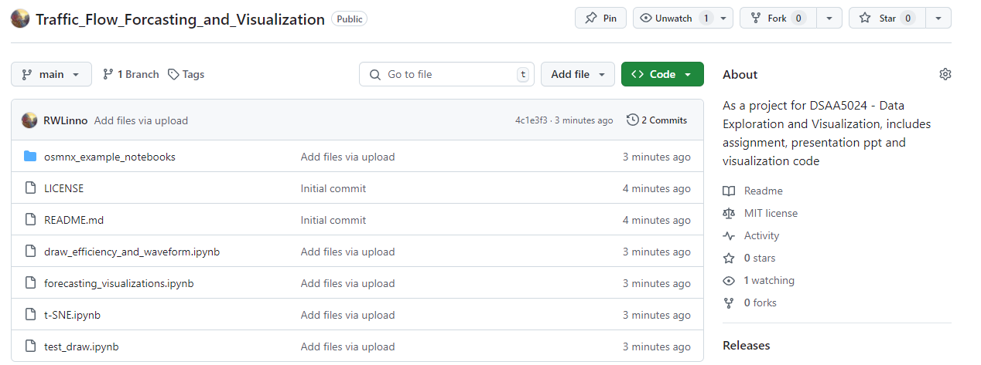
Conclusion
Repo: RWLinno/Traffic_Flow_Forcasting_and_Visualization: As a project for DSAA5024 - Data Exploration and Visualization, includes assignment, presentation ppt and visualization code

Slide 18



Thank You!
Thanks for listening
Q&A
If you are interested in my work, please feel free to talk to me!
Weilin Ruan rwlinno@gmail.com +86 136 725 46637
Notes:
This is all about my presentation, if you are interested in my work, please feel free to discuss it with me!

